Slide 1
AirBNB
Report
Ari Needle and Yosef Axelrod

Slide 2
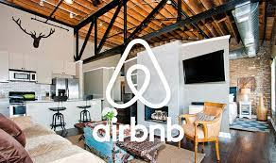
AirBNB Data
This dataset describes the listing activity for AirBNB metrics in NYC for 2019.
Our data includes host’s name, price, availability, amount of reviews, types of airbnbs, minimum nights, and other metrics.

Slide 3

Guiding Questions
What is the average price for an Airbnb rental in NYC, and which borough is the most expensive?
What is the highest price ever charged for an Airbnb rental in NYC?
How many Airbnb rentals are there in NYC, and how many are in each borough?
Who is the host with the most listings in NYC, and how many do they have?
Which borough has the most listings for entire homes/apartments, private rooms, and shared rooms?

Slide 4
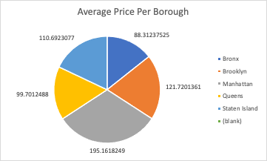
Pricing
When it comes to pricing, the average price for an Airbnb rental is $156.26, with Manhattan being the most expensive borough at an average of $195.16 per night.
The highest price ever charged for an Airbnb rental in NYC is $10,000.
Notes:
Similar customer base to lulu
2018- shift to include streetwear
Both for Lulu lemon and Alo yoga, customers feel very passionate about the brands.

Slide 5
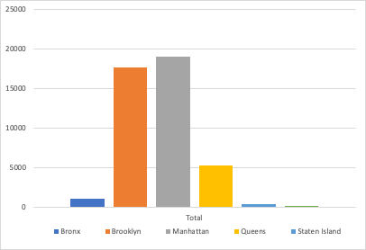
Most Listings
There are a total of 43,416 Airbnb rentals in NYC, with 19,068 in Manhattan, 17,629 in Brooklyn, 5,204 in Queens, 1,002 in the Bronx, and 351 in Staten Island.
The host with the most listings in NYC is Id: 219517861 - Host name: Sonder (NYC) - Amount: 106929.

Slide 6
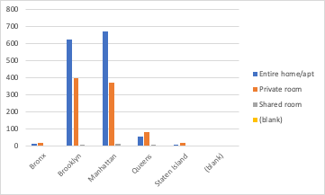
Room Type
Manhattan has the most Airbnb rentals listed as "entire home/apt" with 674, followed by Brooklyn with 624.
Brooklyn has the most "private room" listings with 399, and Manhattan has the most "shared room" listings with 14.
Notes:
Wealthier and therefore willing to pay the high prices of Lululemon products.
The target market is tech savvy and invested in their self image as health conscious and stylish

